Slide 1
ABAP Modularization
Adrian Streitz, Johannes Rank, Borys Levkovskyi

Slide 2
Prerequisites
Navigation experience with ABAP Workbench and Eclipse
Advanced ABAP programming skills
Basic knowledge in ABAP object-oriented programming

Slide 3
Agenda
Introduction
Includes
Function Modules
Business Application Programming Interfaces (BAPIs)
Subroutines (FORMs)

Slide 4

I. Introduction Motivation and Fundamentals
Process of subdividing a program into separate parts
Reuse of certain functions without maintaining several copies
Enables to create independent work tasks for a team of software developers → collaboration
Facilitates to cope with higher complexity → Divide-and-Conquer
Easy identification of software errors
Easy way to extend and substitute existing program code
There are different possibilities to make use of modularization for ABAP

Slide 5
I. Introduction Forms of Modularization
Includes
Function Modules
Business Application Programming Interfaces (BAPIs)
Subroutines (FORMs)

Slide 6
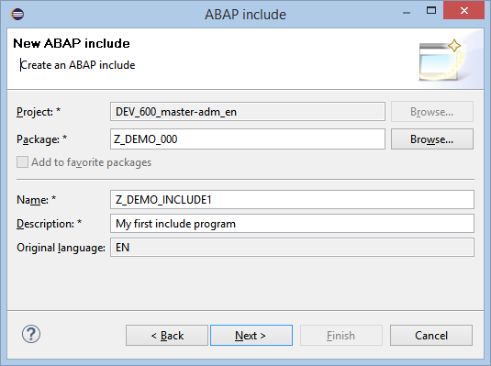
II. Includes First way to reduce complexity
Idea
Outsource to external program
Instruction INCLUDE integrates external program into main program
Drawbacks
Bad maintenance: changes in include programs may cause syntax errors in main programs
High memory consumption → multiple memory allocation of include program

Slide 7

II. Includes Characteristics
No independent run possible → must be integrated into other programs
Include programs may contain other includes
Include programs cannot call themselves
Manual check of calling program by software developer necessary → does the include program fit logically?
INCLUDE | TOP-INCLUDE
no data declaration necessary | contains data declaration
operational code | considered for all syntax checks
 | always integrated for compiler
 | no operational code

Slide 8
III. Function Modules Fundamentals
Outsources functionality to external modules
More than 100,000 function modules available by a default SAP ERP installation
Function modules can be organized in function groups
Function modules can be remote accessible
Function groups may have own TOP-INCLUDE

Slide 9
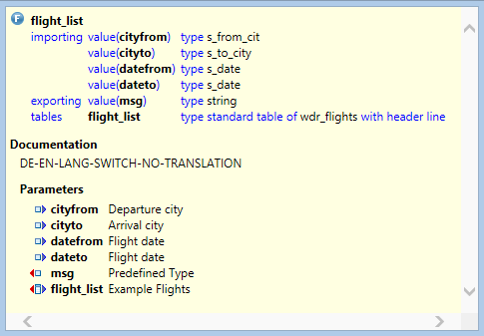
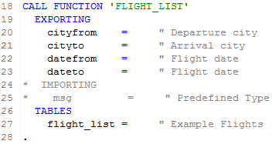

III. Function Modules Export-, Import- and Changing-Parameters
import (FM) = export (ABAP report)
report → FM
export parameter
FM → report
import parameter
table
report ←→ FM
Exceptions are missing in this example, but may be raised by function modules!

Slide 10
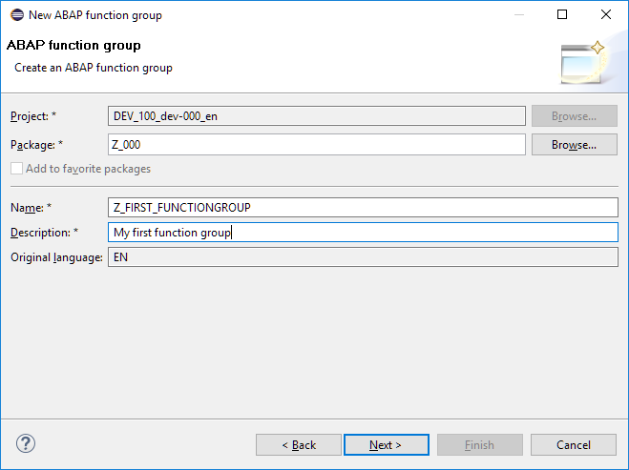
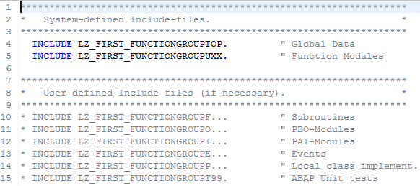
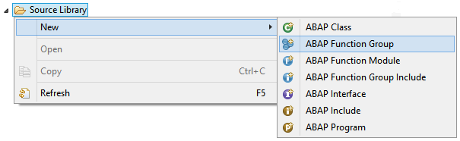
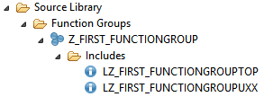
III. Function Modules Function Groups
Container for function modules
Not executable
Holds global data for all containing function modules

Slide 11
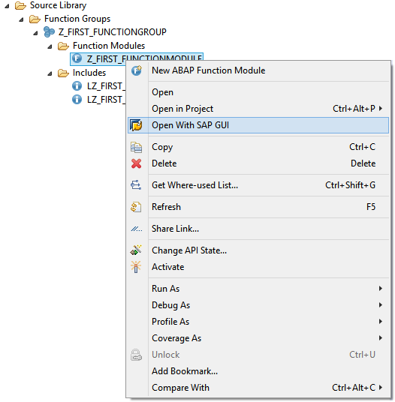
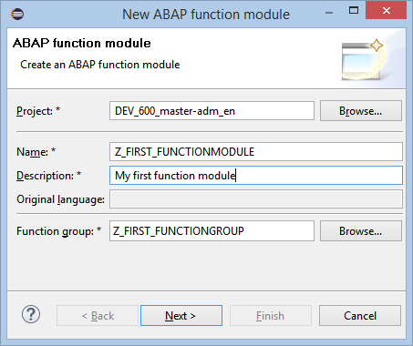
III. Function Modules Create your first Function Module: Step 1
Check whether a suitable function module already exists. If not, proceed to step 2.
Create a function group, if no appropriate group exists yet.
Create the function module.
Define the function module interface by entering its parameters and exceptions (use the Function Builder)
opens the SAP Function Builder

Slide 12
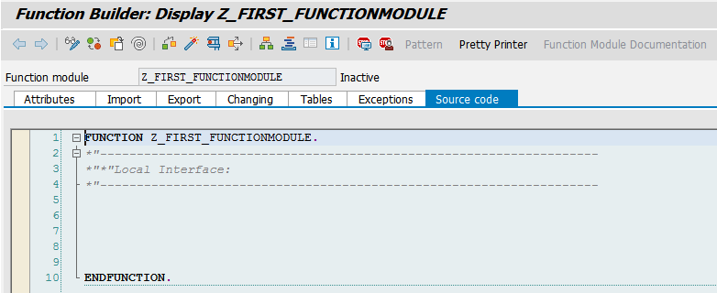
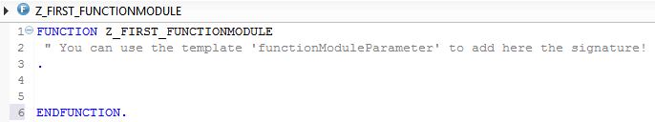
III. Function Modules Create your first Function Module: Step 2
Write the actual ABAP code for the function module, adding any relevant global data to the TOP include.
Activate the module.
Test the module.
Document the module and its parameters for other users.
Release the module for general use.
SAP GUI
Eclipse

Slide 13
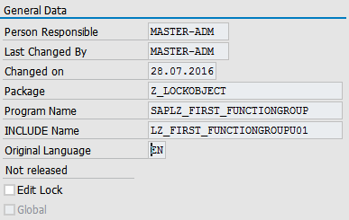
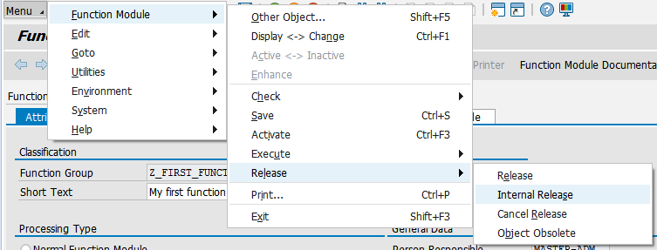
III. Function Module Release Status
External release
for customers
ensure upward compatibility
no future need to change calling statement ever
Internal release
for internal usage
ensure upward compatibility
users have to be informed promptly when function module has changed

Slide 14
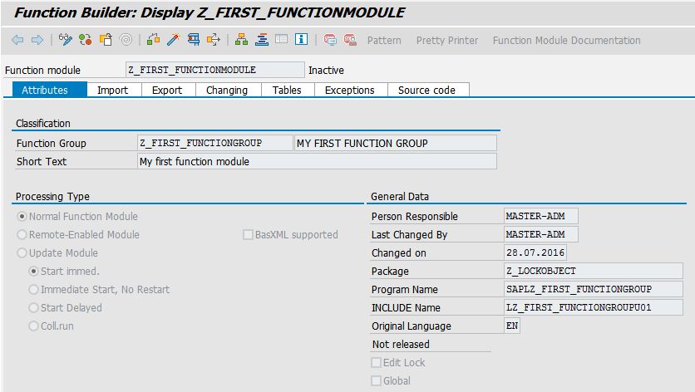
III. Function Modules Function Builder
Function parameters
Function code
General attributes

Slide 15
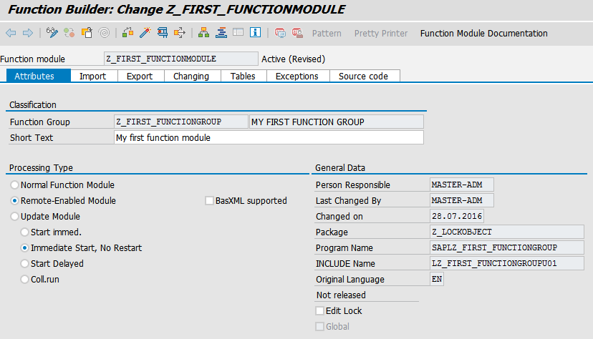
III. Function Module Function Module Types
local function
remote function

Slide 16
IV. Business Application Programming Interface (BAPI) Introduction
Precisely defined interfaces providing access to processes and data of SAP business applications
Special type of RFC enabled function modules
May be accessed outside the SAP system (Visual Basic or Java applications)
Object-based communication between components
Set of interfaces → enables easy integration of third-party software into the proprietary SAP applications
BAPI = Business Application Programming Interface

Slide 17
IV. Business Application Programming Interface (BAPI) Classification
Function Modules
Remote-enabled Function Modules (RFCs)
BAPI
More information about BAPI in Module 11 (BSPs)

Slide 18
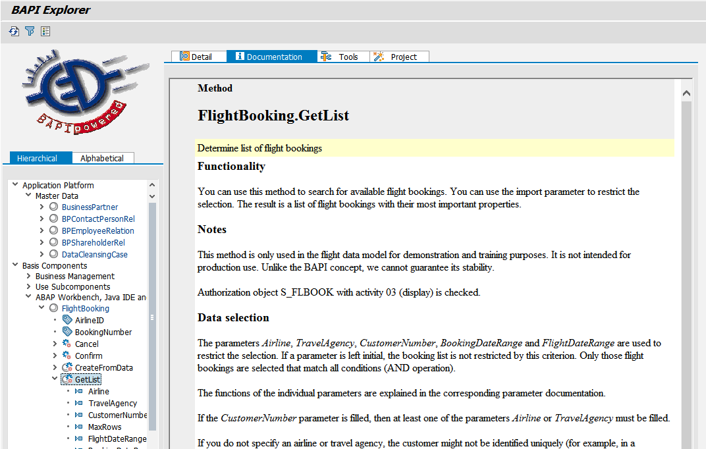
IV. Business Application Programming Interface (BAPI) BAPI Explorer
Most common to use existing BAPIs of the SAP system
Repository of all available BAPIs: BAPI Explorer
Open Transaction BAPI within the SAP GUI
List sorted by:
Alphabetical order
Business areas

Slide 19
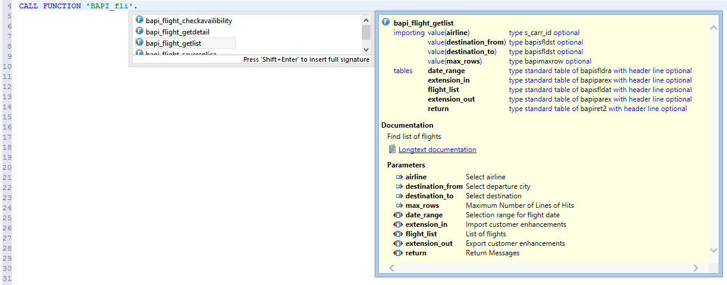
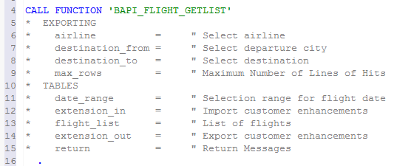
IV. Business Application Programming Interface (BAPI) Usage and application
CTRL + Space
Parameter preview
Shift + Enter

Slide 20
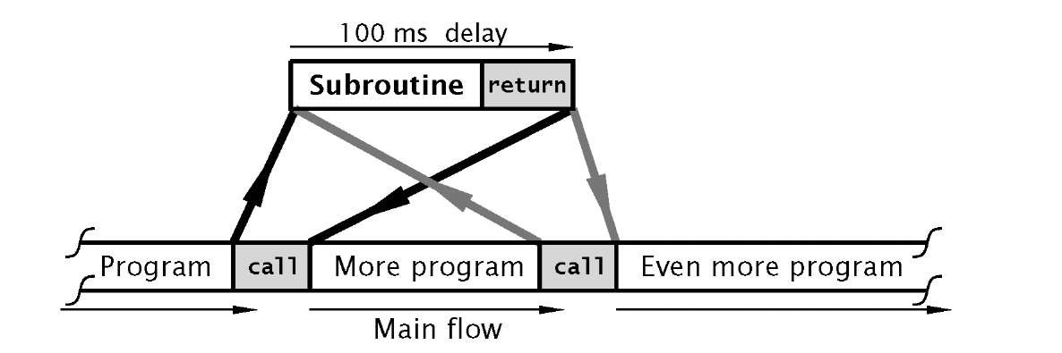
V. Subroutines (FORMs) Fundamentals and Characteristics
Subroutines are procedures in ABAP
Parameter without value declaration means the variable points to the global variable
Parameter with value declaration have their own values
ABAP doesn’t allow nested subroutines
Place your subroutines always at the end of your code

Slide 21
V. Subroutines (FORMs) Defining Subroutine
FORM <procedure name>
USING <input parameter> TYPE <type>
CHANGING <input/output parameter> TYPE <type>
USING value<input parameter> TYPE <type>
CHANGING value<input/output parameter> TYPE <type>.
ENDFORM.
passed by reference
passed by value
For calling by reference, USING and CHANGING are equivalent. For documentation purposes, you should use USING for input parameters which are not changed in the subroutine, and CHANGING for output parameters which are changed in the subroutine.

Slide 22
V. Subroutines (FORMs) Call an existing subroutine
Call subroutine of another program (optional)
PERFORM <procedure name>
[IN PROGRAM <program name>]
USING <input parameter>
CHANGING <input/output parameter>.
read-only parameters
Provide paramaters which may be changed

Slide 23
Now you know how create and use functional modules.
To consolidate your knowledge, you can do task 1 and 2 of the Modularization exercise.

Slide 24
Check your knowledge

Slide 25
Check your knowledge
Using an INCLUDE results in a copy of source code at the calling position of the main program.
□ True □ False
Function modules are totally independent and do not need any other repository objects to be operable.
□ True □ False
Explain the difference between the two learned release states of ABAP Function Modules!
Parameter without value declaration means the variable is locally created and only used within the processed subroutine.
□ True □ False

Slide 26
Solution

Slide 27
Solution
Using an INCLUDE results in a copy of source code at the calling position of the main program.
☒ True □ False
Function modules are totally independent and do not need any other repository objects to be operable.
□ True ☒ False
Explain the difference between the two learned release states of ABAP Function Modules!
See section Release Status
Parameter without value declaration means the variable is locally created and only used within the scope of the subroutine.
□ True ☒ False

Slide 28
References
Schwaiger, R. (2016): Schrödinger programmiert ABAP: Das etwas andere Fachbuch, SAP PRESS, 2016
Keller, H.; Krüger, S. (2006): ABAP Objects: ABAP-Programmierung mit SAP NetWeaver, Rheinwerk Publishing

